Slide 1
Pointers to Pointers
Examples:
Defining, initializing and de-referencing pointers to pointers
Creating and using an array of pointers

Slide 2
r
q
p
a
int a;
int *p;
int **q;
int ***r;

Slide 3
r
q
p
a
&a
int a;
int *p;
int **q;
int ***r;
p = &a;

Slide 4
r
q
p
a
&p
&a
int a;
int *p;
int **q;
int ***r;
p = &a;
q = &p;

Slide 5
r
q
p
a
&q
&p
&a
int a;
int *p;
int **q;
int ***r;
p = &a;
q = &p;
r = &q;

Slide 6
r
q
p
a
&q
&p
&a
int a;
int *p;
int **q;
int ***r;
p = &a;
q = &p;
r = &q;
What is the type of the following expressions?
Expression Type
a
&a
p
*p
&p

Slide 7
r
q
p
a
&q
&p
&a
int a;
int *p;
int **q;
int ***r;
p = &a;
q = &p;
r = &q;
What is the type of the following expressions?
Expression Type
a int
&a int *
p int *
*p int
&p int **

Slide 8
r
q
p
a
&q
&p
&a
int a;
int *p;
int **q;
int ***r;
p = &a;
q = &p;
r = &q;
What is the type of the following expressions?
Expression Type
q
&q
*q
**q

Slide 9
r
q
p
a
&q
&p
&a
int a;
int *p;
int **q;
int ***r;
p = &a;
q = &p;
r = &q;
What is the type of the following expressions?
Expression Type
q int **
&q int ***
*q int *
**q int

Slide 10
r
q
p
a
&q
&p
&a
int a;
int *p;
int **q;
int ***r;
p = &a;
q = &p;
r = &q;
What is the type of the following expressions?
Expression Type
r
&r
*r
**r
***r

Slide 11
r
q
p
a
&q
&p
&a
int a;
int *p;
int **q;
int ***r;
p = &a;
q = &p;
r = &q;
What is the type of the following expressions?
Expression Type
r int ***
&r int ****
*r int **
**r int *
***r int

Slide 12
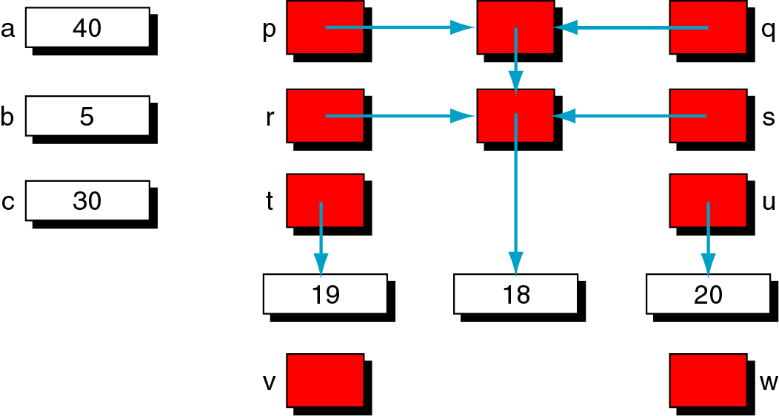
t = **p;
b = ***q;
*t = c;
v = r;
w = *s;
a = **v;
*u = *w;

Slide 13
a
p
x
q
int a;
int b;
int c;
int d;
int e;
int f;
40
b
r
y
s
5
c
t
u
30
d
e
f
19
18
20
v
w

Slide 14
a
p
x
q
int a;
int b;
int c;
int d;
int e;
int f;
int *t;
int *u;
int *y;
40
b
r
y
s
5
c
t
u
30
d
e
f
19
18
20
v
w

Slide 15
a
p
x
q
int a;
int b;
int c;
int d;
int e;
int f;
int *t;
int *u;
int *y;
int **r;
int **s;
int **x;
40
b
r
y
s
5
c
t
u
30
d
e
f
19
18
20
v
w

Slide 16
a
p
x
q
int a;
int b;
int c;
int d;
int e;
int f;
int *t;
int *u;
int *y;
int **r;
int **s;
int **x;
int ***p;
int ***q;
??? v;
??? w;
40
b
r
y
s
5
c
t
u
30
d
e
f
19
18
20
v
w

Slide 17
a
p
x
q
t = **p;
40
b
r
y
s
5
c
t
u
30
d
e
f
19
18
20
v
w

Slide 18
a
p
x
q
*p
t = **p;
40
b
r
y
s
**p
5
&e
c
t
u
30
&e
d
e
f
19
18
20
v
w

Slide 19
a
p
x
q
t = **p;
b = ***q;
40
b
r
y
s
5
c
t
u
30
d
e
f
19
18
20
v
w

Slide 20
a
p
x
q
*q
t = **p;
b = ***q;
40
b
r
y
s
**q
5 18
c
t
u
30
d
e
f
***q
19
18
20
v
w

Slide 21
a
p
x
q
t = **p;
b = ***q;
*t = c;
40
b
r
y
s
18
c
t
u
30
d
e
f
19
18
20
v
w

Slide 22
a
p
x
q
t = **p;
b = ***q;
*t = c;
40
b
r
y
s
18
c
t
u
30
d
e
f
*t
19
18 30
20
v
w

Slide 23
a
p
x
q
t = **p;
b = ***q;
*t = c;
v = r;
40
b
r
y
s
18
&y
c
t
u
30
d
e
f
19
30
20
v
w
&y

Slide 24
a
p
x
q
t = **p;
b = ***q;
*t = c;
v = r;
40
b
r
y
s
18
&y
c
t
u
30
d
e
f
19
30
20
v
w
&y

Slide 25
a
p
x
q
t = **p;
b = ***q;
*t = c;
v = r;
w = *s;
40
b
r
y
s
18
c
t
u
30
d
e
f
19
30
20
v
w

Slide 26
a
p
x
q
t = **p;
b = ***q;
*t = c;
v = r;
w = *s;
40
b
r
y
s
*s
18
&e
c
t
u
30
d
e
f
19
30
20
v
w
&e

Slide 27
a
p
x
q
t = **p;
b = ***q;
*t = c;
v = r;
w = *s;
a = **v;
40
b
r
y
s
18
c
t
u
30
d
e
f
19
30
20
v
w

Slide 28
a
p
x
q
t = **p;
b = ***q;
*t = c;
v = r;
w = *s;
a = **v;
40 30
b
r
y
s
*v
18
c
t
u
30
d
e
f
**v
19
30
20
v
w

Slide 29
a
p
x
q
t = **p;
b = ***q;
*t = c;
v = r;
w = *s;
a = **v;
*u = *w;
30
b
r
y
s
18
c
t
u
30
d
e
f
19
30
20
v
w

Slide 30
a
p
x
q
t = **p;
b = ***q;
*t = c;
v = r;
w = *s;
a = **v;
*u = *w;
30
b
r
y
s
18
c
t
u
30
d
e
f
*w
*u
19
30
20 30
v
w

Slide 31
a
p
x
q
t = **p;
b = ***q;
*t = c;
v = r;
w = *s;
a = **v;
*u = *w;
30
b
r
y
s
18
c
t
u
30
d
e
f
19
30
30
v
w

Slide 32
Creating and using an array of pointers:
32 13 22 13 11
This array needs to be used sometimes as it is and sometimes sorted. How would you solve the problem without copying the array into another array?
Then write code to print the sorted list using an index.

Slide 33
Read a list of numbers into an array:
32 13 22 13 11
This array needs to be used sometimes as it is and sometimes sorted. How would you solve the problem without copying the array into another array? // Use an array of pointers
Then write code to print the sorted list using an index.
list
32 | 13 | 22 | 13 | 11
ptrList
// Arrays before sorting

Slide 34
Read a list of numbers into an array:
32 13 22 13 11
This array needs to be used sometimes as it is and sometimes sorted. How would you solve the problem without copying the array into another array? // Use an array of pointers
Write code to print the sorted list using an index, then a pointer.
list
32 | 13 | 22 | 13 | 11
ptrList
// Arrays after sorting: original array did not change!

Slide 35
A. Write code to print the sorted list using an index.
list
32 | 13 | 22 | 13 | 11
ptrList
int i;
for( i = 0; i < listSize; i++ )
cout << ???? ;

Slide 36
A. Write code to print the sorted list using an index.
list
32 | 13 | 22 | 13 | 11
ptrList
int i;
for( i = 0; i < listSize; i++ )
cout << *ptrList[i];

Slide 37
B. Write code to print the sorted list using a pointer
list
32 | 13 | 22 | 13 | 11
ptrList
pWalk
???? pWalk;
for( pWalk = ptrList; ???? != NULL; pWalk++ )
cout << ????;

Slide 38
B. Write code to print the sorted list using a pointer
list
32 | 13 | 22 | 13 | 11
ptrList
pWalk
int **pWalk;
for( pWalk = ptrList; ???? != NULL; pWalk++ )
cout << ????;

Slide 39
B. Write code to print the sorted list using a pointer
list
32 | 13 | 22 | 13 | 11
ptrList
pWalk
int **pWalk;
for( pWalk = ptrList; *pWalk != NULL; pWalk++ )
cout << ????;

Slide 40
B. Write code to print the sorted list using a pointer
list
32 | 13 | 22 | 13 | 11
ptrList
pWalk
int **pWalk;
for( pWalk = ptrList; *pWalk != NULL; pWalk++ )
cout << **pWalk;

Slide 41
B. Write code to print the sorted list using a pointer
list
32 | 13 | 22 | 13 | 11
ptrList
pWalk
int **pWalk;
for( pWalk = ptrList; *pWalk; pWalk++ )
cout << **pWalk;

